Slide 1
CHAPTER 1
FUNCTIONS AND MODELS

Slide 2
CONTENTS
1.1 Four way to represent a function
1.2 Model and Curve Fitting
1.3 New Functions from Old Functions
1.4 Graphing Calculators and Computers
1.5 Exponential Functions
1.6 Inverse Functions and Logarithmic Functions
1.7 Parametric Curves

Slide 3
1.6 INVERSE FUNCTIONS & LOGARITHMS
1.6.1 One-to-one functions
1.6.2 Inverse functions
1.6.3 Logarithmic functions
1.6.4 Natural Logarithms

Slide 4
1.6.1 one-to-one functions
A bacteriat culture started with 100 bacteriat. The number of bacteriat N is a function of time (hours)
t (hours) | N=f(t)
0 | 100
1 | 168
2 | 259
3 | 358
4 | 445
5 | 509
6 | 550
7 | 573
8 | 586

Slide 5
Reading backward the last table we get t as a function of N
N | t =g(N)
100 | 0
168 | 1
259 | 2
358 | 3
445 | 4
509 | 5
550 | 6
573 | 7
586 | 8
It is possible to do that because f is one-to-one

Slide 6
Definition. A function f is a one-to-one function if:
x₁ ≠ x₂ ⇒ f(x₁) ≠ f(x₂)
4
10
f is one-to-one
3
7
2
4
1
2
f
g is not one-to-one :
2 ≠ 3 but g(2) = g(3)
4
10
3
4
2
1
2
g

Slide 7
Horizontal Line Test. A function f is one-to-one iff no horizontal line intersects its graph more than once:
y=f(x)
f(x₁)
f(x₂)
x₂
x₁
By the Horizontal Line Test this function f is not one-to-one

Slide 8
Example. Is the function f(x) = x³ one-to-one ?
Solution1. If x₁³ = x₂³ then
(x₁ – x₂)(x₁²+ x₁x₂+ x₂²) = 0 ⇒ x₁ = x₂ because
hence f(x) = x³ is one-to-one

Slide 9
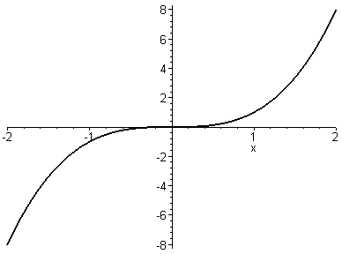
Solution2. No horizontal line intersects the graph of f more than once. So f is one-to-one

Slide 10
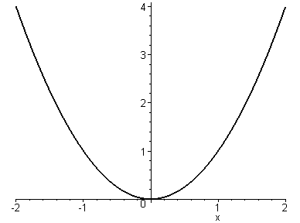
Example. Is the function g(x) = x² one-to-one ?
Solution1. g is not one-to-one because:
g(1) = g(-1) = 1
Solution2. There are horizontal lines that intersect the graph of g more than once. So g is not one-to-one

Slide 11
1.6.2 Inverse functions
Definition. Let f be a one-to-one function with domain A and range B. Then the inverse function f ⁻¹ has domain B and range A and is defined by:
f ⁻¹(y) = x ⇔ f(x) = y, for all y in B
domain( f ^{–1}) = range (f)
range(f ⁻¹) = domain(f)

Slide 12
Example. Let f be the following function
4
-10
3
7
1
3
f
A
B

Slide 13
Then f ⁻¹ just reverses the effect of f
4
-10
3
7
1
3
f ⁻¹
A
B

Slide 14
If we reverse to the independent variable x then:
f ⁻¹(x) = y ⇔ f(y) = x, for all x in B
f ⁻¹(f(x)) = x, for all x in A
f (f ⁻¹(x)) = x, for all x in B
How to find f ^{–1}
Step1 Write y = f(x)
Step2 Solve this equation for x in terms of y
Step3 Interchange x and y.
The resulting equation is y = f ⁻¹(x)

Slide 15
Example. Find the inverse function of f(x) = x³ + 2
Solution. First write y = x³ + 2
Then solve this equation for x:
Interchange x and y:

Slide 16
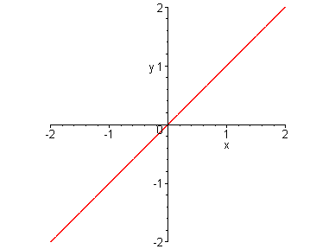
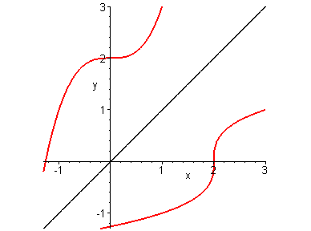
Remark. (a,b) ∈ graph(f) ⇔ (b,a) ∈ graph(f ⁻¹)
Therefore the graph of f ^{–1} is the reflection of the graph of f about the line y=x
(b,a)
(a,b)
f ⁻¹
f

Slide 17
1.6.3 Logarithmic functions
If a > 0 and a ≠ 1 then f(x) = a^{x} is either increasing or decreasing. Therefore f ^{–1} exists and is called the logarithmic function with base a and denoted by log_{a}
log_{a} x = y ⇔ a^{y} = x

Slide 18
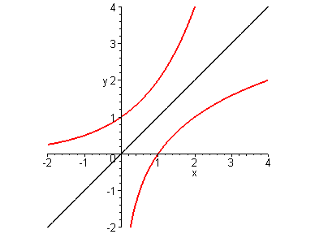
The logarithmic function log_{a} has domain (0,∞) and range R. Its graph is the reflection of the graph of y = a^{x} about the line y = x
y=x
y=a^{x}, a>1
y=log_{a}x, a>1
For a >1, the function y = a^{x} is rapidly increasing therefore the function y = log_{a}x is slowly increasing

Slide 19
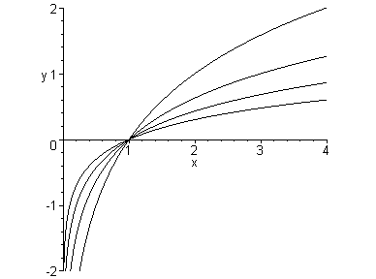
y=log₂x
y=log₃x
y=log₅x
y=log₁₀x

Slide 20
Law of logarithms. If x and y are positive and r any real number then:
Example. Since 2⁴ = 16 we have

Slide 21
1.6.4 Natural Logarithms
The logarithm with base e is called the natural logarithm and noted by ln
ln x = y ⇔ e^{y} = x
ln(e^{x}) = x for every x in R
e^{lnx} = x for all x > 0
In particular ln e = 1

Slide 22
Example. Find x if ln x = 5
Solution 1. ln x = 5 ⇔ e⁵ = x
Therefore x = e⁵
Solution 2. ln x = 5 ⇔ e^{ln x} = e⁵
i.e. x = e⁵

Slide 23
Example. Solve the equation e^{5–3x} = 10
Solution. Taking natural logarithms of both sides:
ln(e^{5–3x}) = ln10 ⇔ 5 –3x = ln10
⇔ 3x = 5 – ln10
Therefore x ≈ 0.8991

Slide 24
Theorem. For a > 0 (a ≠ 1) we have
Proof. Let y= log_{a}x. Then a^{y} = x
Taking natural logarithms of both sides we get
ylna = lnx
Therefore
Example.

Slide 25
Example. Find the inverse function of the mass m=f(t) of ⁹⁰Sr that remains from a 24mg sample after t year.
Solution. Recall that:
Taking natural logarithms of both sides

Slide 26
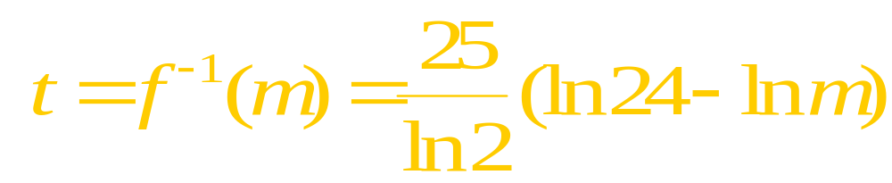
The above function gives the time required for the mass to decay to m mg. In particular if m = 5mg then.

Slide 27
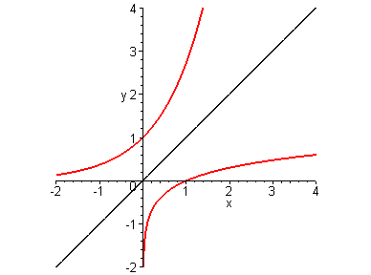
Since the graph of the natural logarithm function lnx is the reflection of the graph of y = e^{x} about the line y = x, its slope at (1,0) is also 1.
y=x
y=e^{x}
y=lnx
Since e >1, the function y = lnx is slowly increasing

Slide 28
The natural logarithm function lnx grows slower than square root: their ratio tends to 0 when x become large
x | 1 | 2 | 5 | 10 | 50 | 100 | 500 | 10³ | 10⁴ | 10⁵
lnx | 0 | 0.69 | 1.61 | 2.3 | 3.91 | 4.6 | 6.2 | 6.9 | 9.2 | 11.5
 | 1 | 1.41 | 2.24 | 3.16 | 7.07 | 10 | 22.4 | 31.6 | 100 | 316
 | 0 | 0.49 | 0.72 | 0.73 | 0.55 | 0.46 | 0.28 | 0.22 | 0.09 | 0.04

Slide 29
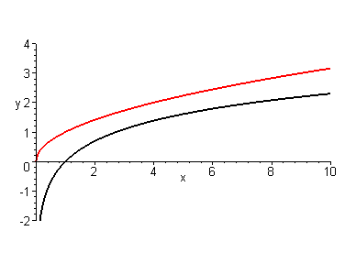
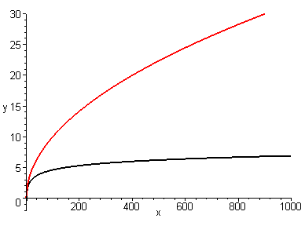
y=lnx
y=lnx

